Slide 1

Exploratory analysis of Big Data and Cloud
big Data tools

Slide 2
Big data tools
Big Data tools are essential for processing, storing, and analyzing massive datasets efficiently. They fall into different categories based on their functionality:
1. Data Storage and Processing
2. Data Warehousing and Querying
3. Data Ingestion and ETL
4. NoSQL Databases
5. Machine Learning and AI on Big Data
6. Data Visualization and BI

Slide 3


Data Storage and Processing
Apache Hadoop – Distributed storage (HDFS) and batch processing (MapReduce).
Apache Spark – Fast, in-memory processing engine for big data analytics.
Apache Flink – Real-time stream processing framework.
Apache Storm – Distributed real-time computation system.

Slide 4
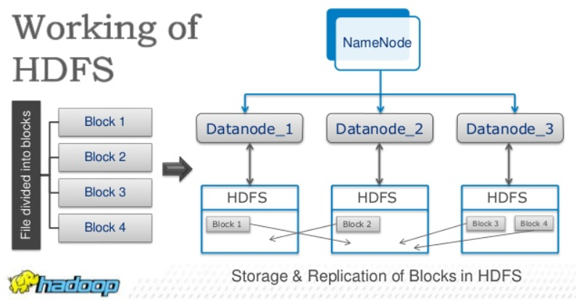
Hadoop

Slide 5
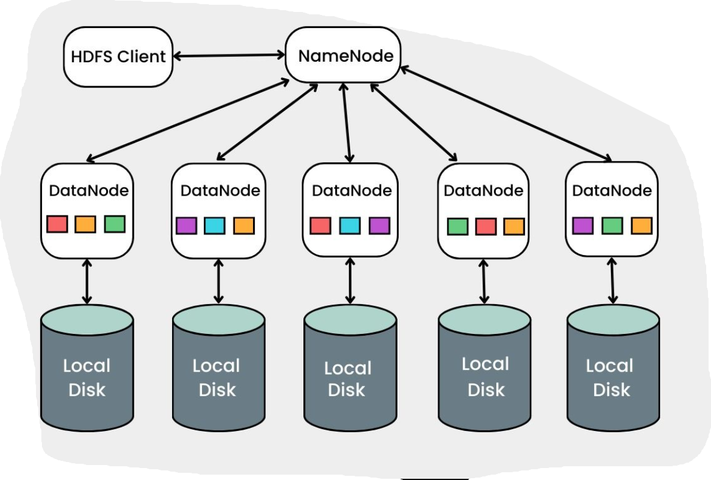
Apache Hadoop

Slide 6
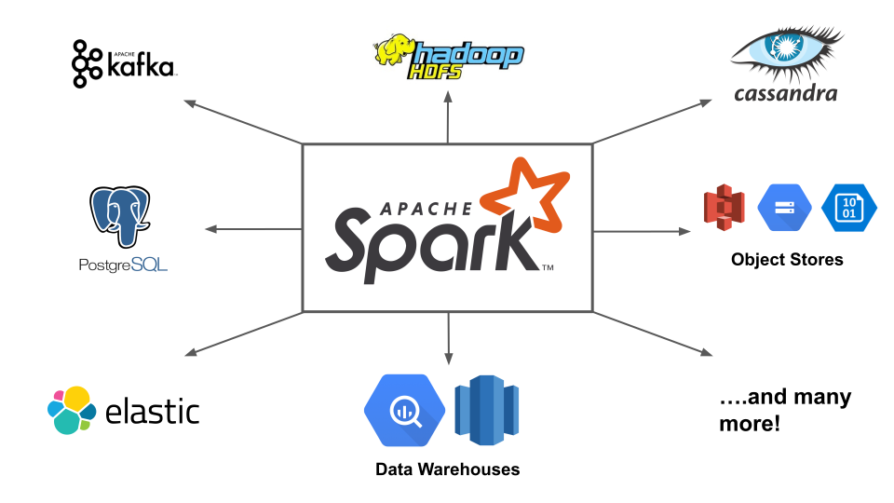
Apache Spark

Slide 7
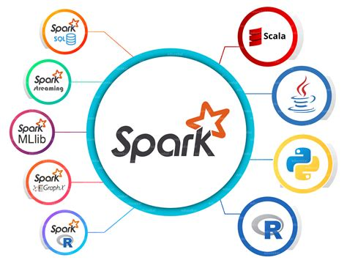
Apache Spark

Slide 8
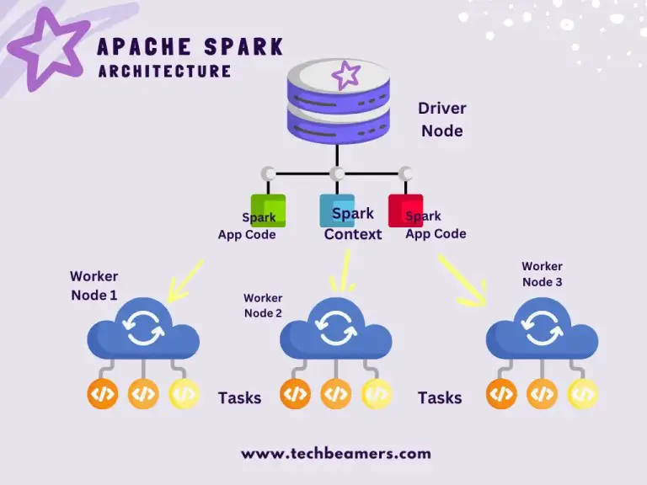

Slide 9
Data Warehousing and Querying
Apache Hive – SQL-like querying on Hadoop.
Presto (Trino) – High-performance distributed SQL query engine.
Google BigQuery – Serverless data warehouse with fast SQL queries.
Amazon Redshift – Cloud-based data warehouse.

Slide 10


Data Ingestion and ETL
Apache Kafka – Real-time event streaming platform.
Apache NiFi – Data flow automation and management.
Airflow – Workflow automation and scheduling.
Talend – ETL and data integration platform.

Slide 11

NoSQL Databases
Apache Cassandra – Scalable NoSQL database for high availability.
MongoDB – Document-oriented NoSQL database.
HBase – Column-oriented NoSQL database on Hadoop.
Amazon DynamoDB – Managed NoSQL database.

Slide 12

Machine Learning and AI on Big Data
MLlib (Apache Spark ML) – Scalable machine learning library.
H2O.ai – Open-source AI and ML platform.
TensorFlow on Apache Spark – Deep learning on big data.
Hugging face Transformers

Slide 13
Data Visualization and BI
Tableau – Interactive data visualization.
Power BI – Business intelligence and reporting.
Apache Superset – Open-source BI tool.

Slide 14
Focus on user-friendly tools that illustrate key big data concepts
1. Data Storage & Processing
Google Colab + PySpark – Allows running Spark without installation, making it easy to demonstrate distributed computing concepts.
Apache Hadoop (HDFS + MapReduce concepts) – Use a simple local setup (e.g., Dockerized Hadoop) to introduce batch processing.
2. Data Querying & Warehousing
Google BigQuery – Serverless SQL-based querying with a free tier, making it great for demonstrating big data queries without setup hassle.
Apache Hive (via cloud platforms) – Helps explain SQL over big data.

Slide 15
Focus on user-friendly tools that illustrate key big data concepts
3. Data Streaming & Ingestion
Apache Kafka (via Confluent Cloud or Docker) – Use simple producers/consumers to demonstrate real-time data streaming.
Apache NiFi – A low-code tool for data flow management, great for non-programmers.
4. Data Visualization & BI
Power BI / Tableau (with Big Data sources like BigQuery or Hive) – Helps students see the impact of big data analysis visually.
Apache Superset – Open-source alternative to Tableau, useful for SQL-based exploration.
ML on Big data
MLlib (via PySpark on Google Colab) – Demonstrates scalable ML with minimal setup.
H2O.ai (AutoML features) – Helps students see AI applications without complex coding.
Hugging face Transformers on Colab

Slide 16
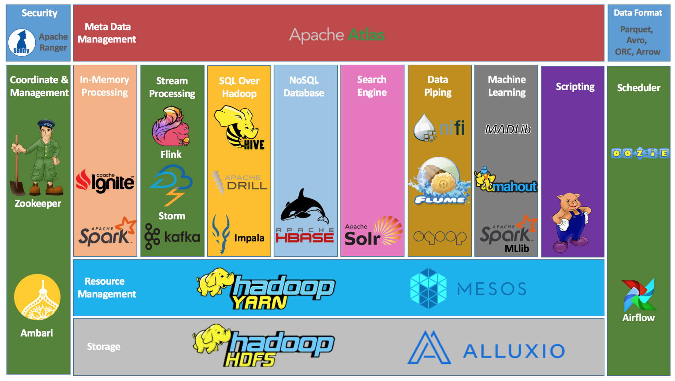

Slide 17

Questions

